Slide 1
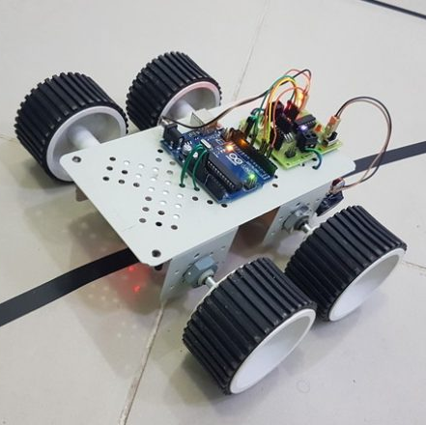
Team Robusta Presents
“Industrial Line Follower Robot”
SAKIBUL ALAM SAKIB [2001032]
Presenter Name
SHIMUL MAHMUD KHATAMI [2001037]
RAKIB HASAN [1801047]
MD. MAHMUDUL HASAN [1901047]

Slide 2



Topics
Introduction
Objectives of ILFR
Working Principle
Circuit Diagram
Algorithm
Related Works
Conclusion

Slide 3




Introduction
In today's fast-paced industrial landscape, automation plays a crucial role in optimizing efficiency and productivity. One area where automation has made significant strides is in the field of robotics. Industrial line follower robots have emerged as a remarkable solution for streamlining various manufacturing processes.
A line follower robot is an intelligent machine designed to autonomously navigate a predefined path by tracking a line, often a contrasting color, on the floor or surface. This technology has revolutionized the industrial sector by enabling robots to perform intricate tasks with precision and consistency.

Slide 4

Objectives of ILFR
The robot must be capable of following a line.
It should be capable of taking various degrees of turns.
It must be insensitive to environmental factors like lighting and noise.
With the Ultrasonic Sensor Connected to it, it must stop when it detects object.

Slide 5
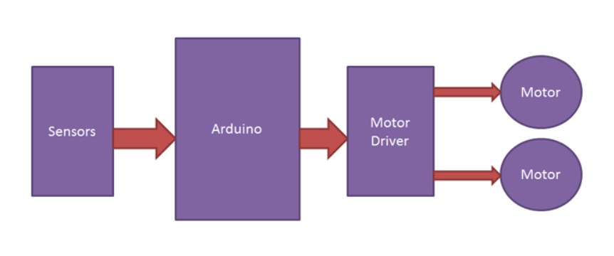
Working Principle
Line Detection
Sensor Reading
Line Tracking
Direction Control

Slide 6
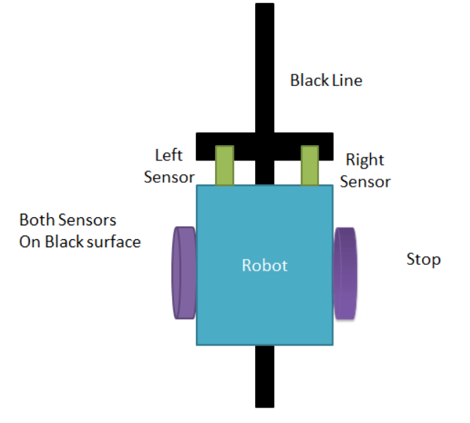
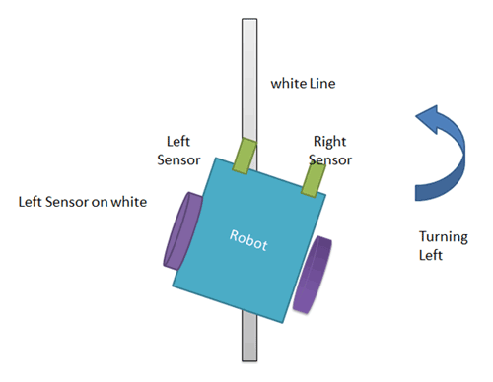
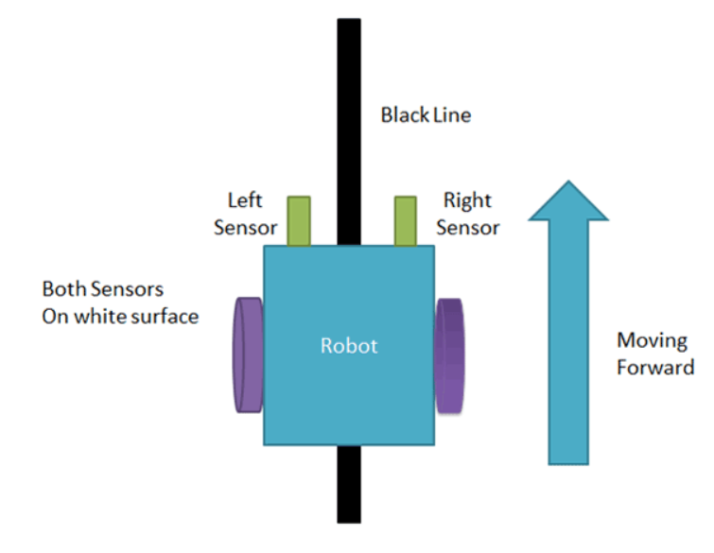
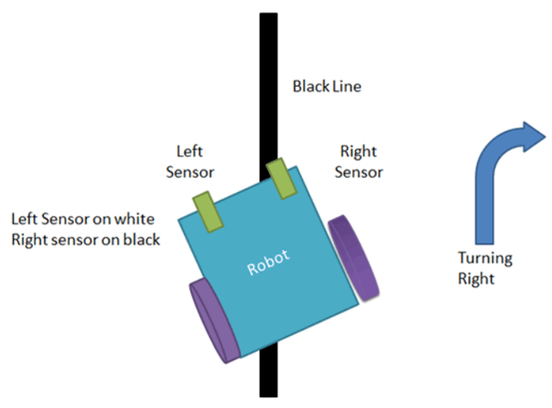
Working Principle

Slide 7
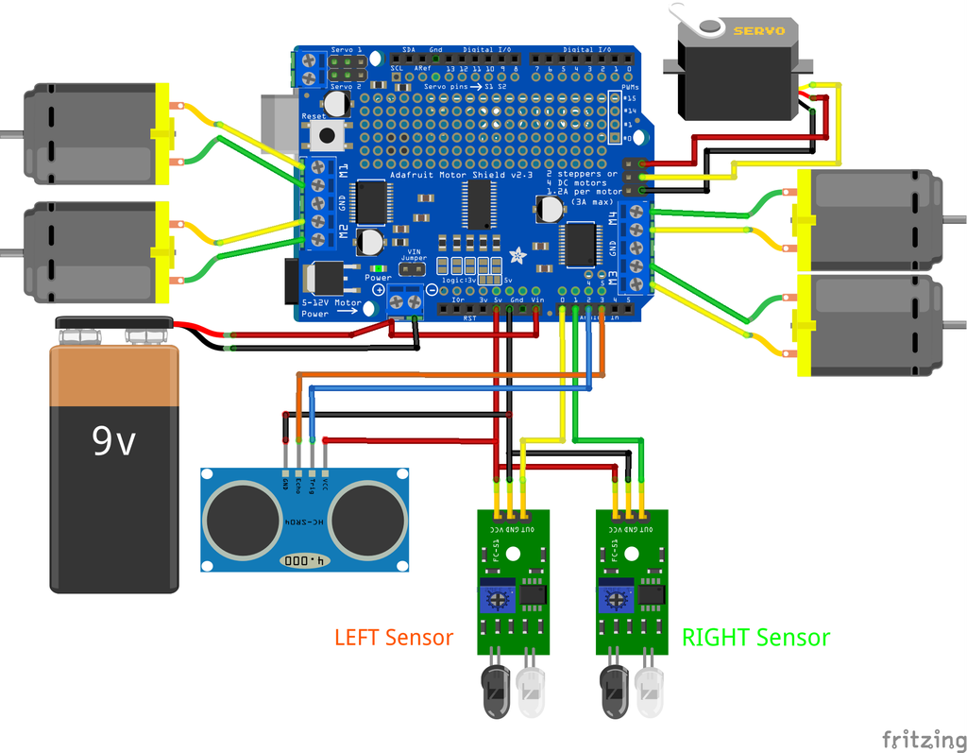
Circuit Diagram

Slide 8

Algorithm
Initialize
Initialize the robot's sensors, actuators, and control system
Read
Read sensor data to detect the line and any obstacles in the robot's path.
Process
Process the sensor data to determine the position of the line relative to the robot and the presence of any obstacles.
Check
Check for the presence of obstacles.
Generate
Generate obstacle detection commands.
Execute
Execute the obstacle detection commands to adjust the robot's trajectory and stop if any obstacle is detected.
Repeat
Repeat steps 2-6 in a continuous loop to maintain real-time line tracking and obstacle avoidance.

Slide 9
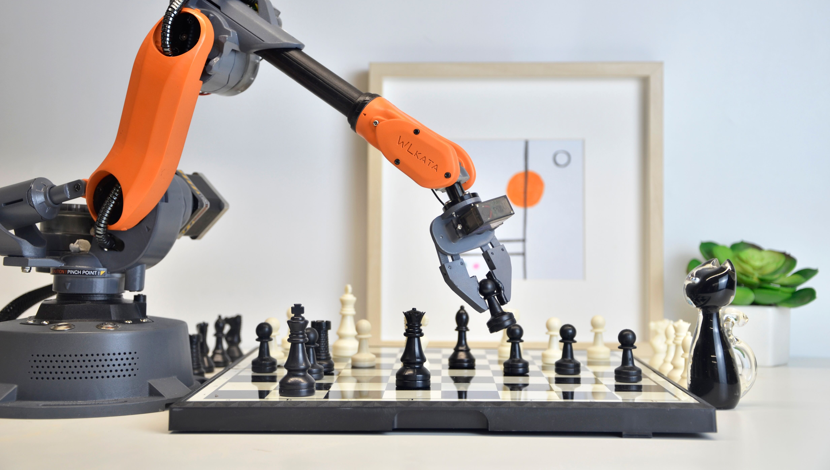
Related Works
"Development of an Industrial Line Follower Robot for Material Handling Applications" by Smith et al. (2018)
"Integration of Line Follower Robots in Automated Assembly Lines" by Chen et al. (2020):
"Real-Time Path Planning and Obstacle Avoidance for Industrial Line Follower Robots" by Kim et al. (2019)
"Vision-Based Industrial Line Follower Robot for Quality Inspection in Electronics Manufacturing" by Li et al. (2021)

Slide 10


Conclusion
In conclusion, industrial line follower robots have become indispensable assets in modern manufacturing environments. Their ability to autonomously navigate and perform a wide range of tasks with precision and efficiency is revolutionizing industrial automation. As technology advances, we can expect these robots to continue evolving, transforming the way industries operate and ushering in a new era of streamlined and intelligent manufacturing processes.

Slide 11

Thank You

